Slide 1

Predicting Stock Direction
Notes:
Hello everyone, welcome to this new video. And in fact, I should say, new hands on video in which we are going to learn about how we can predict the stock's direction tomorrow. So it is a very exciting topic because we are essentially trying to predict the future stock price. And further, take our decision, according to that. So I hope you're as excited as I am. So let us get started.

Slide 2
AGENDA
A Brief Overview of Stock Market.
Getting Familiar with Stock Market Data.
What does Prediction of Stock Direction mean?
How can we achieve this? (Methodology).
Pseudocode for stock direction prediction…
Import required Libraries
Get the data using pandas_datareader
Extract the price column and scale the column
Split the data in training and testing
Create Features (Feature Engineering)
Fit the model.
Test the model and plot the results.
Task for you.
Notes:
on this slide, I will be talking about what is going to be the agenda of the video, and the agenda, make sure that we are constantly following a set of guidelines in this particular video or in any video for that matter. So that is why I always put agenda in my all of the tutorial and hands on video, so that you don't get lost, as a student and I don't get lost as a teacher in teaching some topic. Okay, so let me briefly talk about each of those topics one by one. So I will be starting with a brief discussion on stock market. Obviously you guys must be familiar with the stock market but still some of you. If you are not familiar, then don't worry, this particular introduction will clear each and every concept, and after that we are going to be actually looking at what kind of stock data that this market generates. Okay, and after that we are going to be considering, and taking up the problem that that is at hand out at ourself, which is stock direction prediction and we will be actually trying to understand what exactly do we mean by this, or are we on the same page. I mean, do you understand what I understand by this term called stock direction.
Then, I will be laying out the methodology for doing this. What is going to be the exact algorithm that I'm going to follow for implementing this stuff. And then, we will be starting with writing our own Python code to actually do this stuff. And I have divided this whole task into a set of six pseudocode, and I feel, this will really help you, because by pseudocode you can follow what exactly is going on right now in the code, and you will be able to go back and forth with the help of these pseudo course. Okay, finally, I will have some task for for you, and I think you will be really amazed at how wonderful those tasks will turn out after you complete them.

Slide 3
Overview of Stock market
Every corporation need finance to run their operations.
Some finance need can be accomplished by Capital and some by taking Loan from banks.
But, still they need more. What they can do?
They can issue shares of their company for public to purchase.
When someone purchases the share (stock) they will have some part in the business profits too.
Now, there are many organisations who trade shares with public. How is the price of their stock is decided?
Yes, you guessed it right, It is decided by Stock Market where each corporation takes part in Stock Trading and they get the best price according to demand and supply equilibrium.
Notes:
On this slide, I will be talking about the overview of the stock market. Now I'm giving you some, some time to read these seven points, and to actually understand what does stock market mean by yourself. Obviously I will be explaining you but for the time being, let's understand from the points itself, and I hope that 90% of the concepts will be clear from the points itself. And if you have given some time to read these points, then it would be better for me also and for you also to understand it for myself. Okay, so the first point talks about every corporation need finance to run their operation. So, this talk, are essentially related to finance how because every corporation every company needs money. They can either get money through capital. They which owner brings, and they can or, or they can bring money, finance, through some sort of loans from Bank, or there is also a third way, and third ways actually to issue shares of their company. So, they want to let public know that you can purchase some shares of our company in return off that we you will have to pay some money to us. So people or public pay money to these companies, and these companies offer some shares in their corporations. Now, what is the profit for a shareholder or for a public who is purchasing a company's share. So, for them, they will earn some profits once companies in profit. Okay, so this is the whole idea. Now there are many organizations in the world, all those organizations, how does prices of their shares are decided. So all of these are decided by stock market. Okay, so by demand and supply equilibrium. There are some external factors also like if a company is actually doing really well then their stock prices are bound to increase, and if they are not doing well then it is bound to decrease. Okay, so this is the whole idea behind the stock market and stock market is a market of shares. Okay, their shares are purchased and sold, and they are purchased and sold based on their decision whether the prices, when prices starts to go up many people start to sell, sell their stocks to somebody else. So for example I am having some stocks for which I see that currently the prices declining, day by day so I'll sell it to somebody else. Now somebody else might be thinking that this price. I'm gonna I'm getting this stock for less price, but it will increase in the future because I am selling it because I'm seeing this is this is a less price. Other people might think it is, as an opportunity he might see that, that this price is decreasing now but I can get this stock for less but I will earn more in the future.

Slide 4
Stock Market Data
Let us take a corporation called A.
A let their shares be purchased or sold in stock market. Whey they do this, on a daily basis, for A’s stock various values are generated which are important indicators for someone who is looking for investing in the stock of A. Those indicators are:
Highest Price in a Day (High)
Lowest Price in a Day (Low)
Volume Traded in a Day (Volume)
Opening Price (OPEN)
Closing Price (Close)
Adjusted Close
Notes:
So now let us understand what type of data, a stock market generates for that we need to take an example of any corporation, let us say we have a corporation called Facebook. For any given day, Facebook, can generate six variables, highest price in a day, which means the highest price at which Facebook's stock got traded in that particular day, lowest price in a day, which is quite self explanatory volume created in that particular day, how many shares of Facebook are traded in that particular day will be known as volume opening price. The price at which Facebook's stock, got started selling or purchasing and closing price, and there is one more variable called adjusted clothes, which is just a fancy way of saying some, some clothes. After making some adjustment.

Slide 5
Stock Prediction Objective
Essentially, if we are today trading in a particular stock say A, we would be interested in knowing what will be the price of A tomorrow.
This is what precisely what we are trying to do in this video.. To predict whether the price of the stock will go up or down.

Slide 6
Methodology
The stock data is a sequential data (indexed by time) and we would like to know what will be the next term in this sequence of price. Here is what we are going to do….
For every price Xt, we will take a look at previous n number of prices as a feature to predict this Xt. So, we will essentially take X_{t-1},X_{t-2},..X_{t-60} to predict the price X_{t}.
In this way, we will make a training data where we will consider each price as dependent variable and corresponding past 60 values as independent variable and we will try to fit some models on this data.

Slide 7
Pseudocode for this task

Slide 8
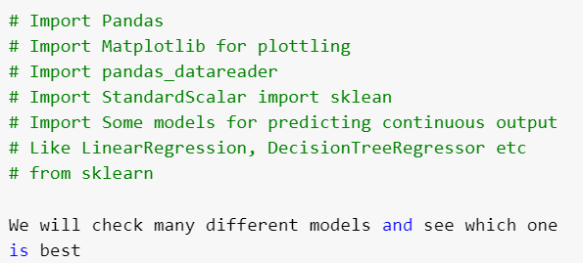
Importing Required Libraries

Slide 9
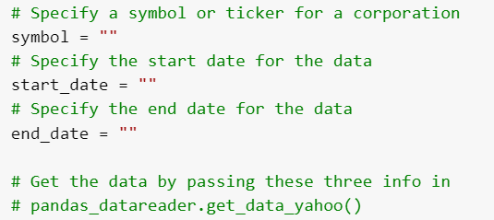
Get data using pandas_datareader

Slide 10
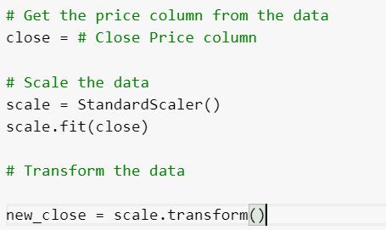
Scaling

Slide 11
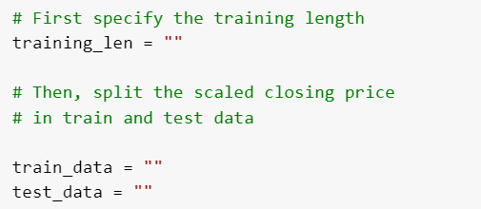
Get the train and test data

Slide 12
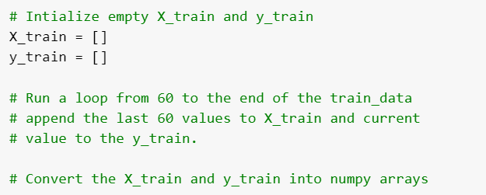
Create Features

Slide 13
Fit and Test the model
Now, use the train test to fit as many as different models you can.
Test each model’s score and measure the performance.

Slide 14
Task for you
We have just implemented various algorithms, and measured score for various score for a specific stock.
Now, your task is to repeat the same sequence of steps for many other stocks say Microsoft, Facebook, Amazon etc.

Slide 15
Thank you

